Slide 1
Theatre and Society
Conner Milliken
c.milliken.1@research.gla.ac.uk

Slide 2
PREVIOUS LECTURE
social and economic context: Britain of the 1970s​
the emergence of the ‘alternative’ theatre movement​
7:84 (Scotland) and The Cheviot, The Stag and the Black Black Oil​
contemporary Scottish case studies: Rantin’ (2014), The Pure, The Dead & The Brilliant (2013), Early Days (of A Better Nation) (2014-5)..

Slide 3
POST-1968 British THEATRE 3:​ THEATRE AS PUBLIC FORUM Trigger warning: Sensitive themes (terrorism, incarceration, (state) violence, LGBTQ+ issues), Bad Language.
THEATRE AND SOCIETY

Slide 4
TODAY’S LECTURE
Theorising theatre as a public forum
Talking to Terrorists and The Riots
NTW and Tim Price’s The Radicalisation of Bradley Manning

Slide 5
THEATRE AS PUBLIC FORUM
Some ideas and claims
a historical tradition? Ancient Greek theatre as a public institution that ‘stood alongside other public forums as a place to confront matters of import and moment’ (Rehm 2005: vi)
‘The origins of the public sphere lie in antiquity are intimately connected with the relationship between theatre and the polis. […] A prerequisite for any public sphere and another notion first adumbrated by the Greeks is the right to speak and to criticize..’ (Balme 2014: 23)
Jurgen Habermas’ notion of the ‘public sphere’ as a space of universal access, autonomy, equality of status and rational exchange of arguments (see Balme 2014: 5)
Nancy Fraser’s (1990) critique of Habermas: ability to participate in the public sphere has been frequently delineated by gender and class status

Slide 6
THEATRE AS PUBLIC FORUM
Michael Warner (2002) calls attention to the ‘poetic world-making’ element of public discourse – in other words, constituted not only through rational-critical debate but involving desire and imagination
‘…the theatre in performance mode remains a realm of emotional intensity, eliciting a wide variety of libidinal and affective as well as cognitive response. The theatrical public sphere is affected when these intensities spill out of the auditorium and intervene and engage with sensitive social discourses’ (Balme 2014: 15)
In Utopia in Performance, Jill Dolan discusses The Laramie Project as serving to create ‘a conversation among people who might not otherwise have spoken to each other – or not spoken words in this way – creating a new public sphere in which to scrutinize the events leading up toe and following Shepard’s death’ (2010: 113)
also see Augusto Boal’s ‘forum theatre’, a participatory model which turns spectators into ‘spect-actors’ who are active participants in the performance

Slide 7
ROBIN SOANS’ TALKING TO TERRORISTS (2005)
developed through research interviews undertaken by Soans, director Max Stafford-Clark and members of the cast – a kind of documentary drama? See Dee’s lectures in a few week’s time
juxtaposes figures from a number of different conflicts and countries (the UK/Northern Ireland, Palestine, Uganda); includes material with interviews from a number of high profile political figures (the former Northern Ireland Minister, Mo Mowlem, and the former ambassador in Tashkent, Uzbekistan, Craig Murray)
emphasises and argues for value (if not necessity) of peaceful negotiations over violent, military interventions

Slide 8
TESTIMONY
Soans and Stafford-Clark’s preface to the script:
One story we heard seemed particularly significant. A relief worker told us of arriving at a large village which had been completely destroyed. The people there were angry not because they had nothing to eat and nowhere to live but because no-one had listened to their story of what had happened. ‘A huge part of what we call terrorism arises from no-one listening,’ she said.
theatre as giving a voice to the voiceless?
For me, stating the problems more clearly isn’t just a case of asking interesting questions, it is also about widening the number and variety of people you listen to, to include people who traditionally haven’t been seen and heard in the theatre’ (Soans in Hammond and Steward 2012: 13)

Slide 9
ROBIN SOANS’ TALKING TO TERRORISTS (2005)
Style and structure:
mix of named characters and those identified by role or job (e.g. ‘an ex-member of the Irish Republican Army’, ‘another ex-secretary of state’, ‘an ex-ambassador’); testimony of those in authority/power with those ‘on the ground’ of conflict around the world
occasional reflexive recognition of interview process as theatrical process (e.g. Edward ‘I think I gave my peak performance last time.. this may be something of a matinee performance’)
privileges direct address or the illusion of direct speech: the characters talk to the audience as thought to an unseen interviewer, rather than to each other (with some notable exceptions e.g. the Foreign office committee)
technique of juxtaposing counterpointing experiences e.g. act two’s movement between the IRA bomber who planted the explosive at the Brighton hotel during the 1984 Conservative party conference and ‘Caroline’, a conference attendee (and then later, an unnamed ex-secretary of state and his wife – identifiable as Norman and Margaret Tebbit)

Slide 10
STRUCTURE
Soans describes the active relationship of the audience to the interviews in terms of surrogate witnesses, where the interview subject talks to the audience just as the original talked to him:
‘..by this process, the audience have become me, or whomever I happened to be with when I conducted the interview’, talking to the audience on ‘a purely personal and confidential level’ (Soans in Hammond and Steward 2012: 19-20)
Where might we recognise this dynamic at work in the play?
the opening sequence with the former secretary of State for Northern Ireland (Mo Mowlam)
Phoebe, the relief worker: ‘It’s really difficult for me to talk to you..’
Notes:
Theatrical forum as both public and intimate (private)

Slide 11
PLAYWRIGHT AS EDITOR?
Structure as a form of content:
‘In my own plays, I have moved from plays that comprise a succession of monologues, to something much more complex and intricately structured, weaving strands of narrative into the source material to give it shape and make it accessible and interesting’ (Soans, 2012: 23)
On the role of the playwright as interpreter:
‘Just because I write about real people and seek to portray them honestly, is there an embargo on editing creatively? Would you say to photographers that they have no right to interpret – or crop? That all their subjects should be film straight on, in nothing other than a flat light?’ (2012: 33)

Slide 12
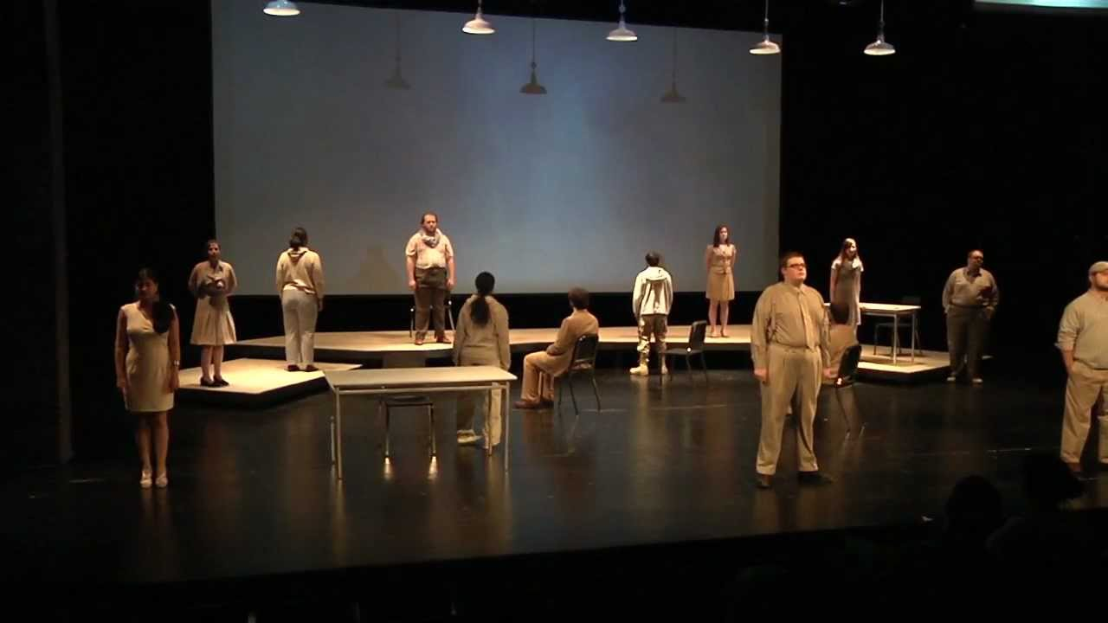
CRITICAL RESPONSES?
As Aleks Sierz detected in Tribune: ‘By treating all extremists as the same, Soans throws politics out of the window’. In the end, and in stark contrast to the project's explicit purpose to investigate ‘what makes ordinary people do extreme things’, the structure of the play repeatedly juxtaposed a misguided ‘terrorist’– identified only by the initials of the extremist movement to which s/he used to belong – and an articulate ‘ordinary person’– that is, a psychologist, a relief worker, a colonel – who could frame the former's behaviour. (Botham 2008: 314)
The coherence of Stuff Happens and humanity of Talking to Terrorists privilege a presentation of the world as ordered, liberal and reasonable over the chaos, incoherence and fantastic of war and terror and […] provides a form of wish fulfilment for its audiences. (Hughes 2007: 153)

Slide 13
GILLIAN SLOVO’S THE RIOTS (2011)
work based on eyewitness accounts of London riots in summer 2011, following the death of Mark Duggan
originally framed at the Tricycle Theatre as a ‘public enquiry’ in the absence of a formal government investigation
text produced from around 55 hours of taped material, selected on the basis of ‘telling the story’ – see: http://www.bbc.co.uk/news/entertainment-arts-15852280
for further context, see Reading the Riots (LSE & The Guardian): http://www.theguardian.com/uk/series/reading-the-riots

Slide 14
Gillian Slovo’s process in developing The Riots:
My researcher and I started a search for interviewees - community activists, politicians, police, victims and the rioters themselves. Finding people who looted and rioted was our biggest challenge because they were either in prison, or awaiting trial and not allowed to talk, or they hadn’t been caught and wouldn’t talk. […] I ended up with 55 hours of tape from my interviews and since the play is only two hours long I had to make some tough decisions about what went in. We have strict rules about verbatim theatre at the Tricycle [Theatre]. You can’t give characters words they haven’t said but you can edit their words.
Slovo, ‘Writing The Riots’, The Arts Desk, 2011. http://goo.gl/dtJ8Ry

Slide 15
Compare with David Hare and Max Stafford-Clark / Joint Stock’s methodology for The Permanent Way:
So is the play 'by' David Hare? The truth is that the production has four authors. Max Stafford-Clark took the lead in choosing people to talk to, in laying down the form of the play and in briefing and sending out the actors to do the interviewing. The cast brought back the words and the 'characters', selecting and interpreting them in their own way. The interviewees themselves - stockbrokers, railway workers, policemen, crash survivors - provided the raw material.
Neal Ascherson, The Observer, 2003. http://goo.gl/SKqlSz

Slide 16
Verbatim: ‘word for word; in the exact words’
(OXFORD ENGLISH DICTIONARY)
My sense of truthfulness to the interviewee puts the emphasis on representing them truthfully in spirit. I might make small changes to the text for the sake of clarity or fluidity, but I take great pains to preserve the sense, tone and thrust of an interviewee’s words.
(SOANS IN VERBATIM VERBATIM, 2009: 3)
..they come back and offer you an improvisation which is based on notes they have in front of them, so that they say exactly what the person said.
(HARE IN INTERVIEW WITH RICHARD BOON, COTTESLOE THEATRE, 27 JANUARY 2004; HTTP://GOO.GL/GKRX29)
You can’t give characters words they haven’t said but you can edit their words.
(GILLIAN SLOVO, ‘WRITING THE RIOTS’, THE ARTS DESK, 2011. HTTP://GOO.GL/DTJ8RY )

Slide 17
Tim Price: The radicalisation of Bradley Manning
produced by National Theatre Wales as touring production in Wales during 2012, re-staged for Edinburgh Fringe Festival in 2013.
originally staged in Tasker Milward School in south west Wales which Manning had attended as a teenager
to date, every performance has been accompanied by simultaneous live online broadcast, shown with curated links intended to depict Manning’s ‘online existence’. See: http://nativehq.com/bradley-manning-ntw18/

Slide 18
Tim Price: The Radicalisation of Bradley Manning
Manning was held in detention at time of original production, and had been found guilty and was awaiting sentence during the Edinburgh Fringe revival
Manning’s statement on morning following sentencing: ‘I am Chelsea Manning. I am a female. Given the way that I feel, and have felt since childhood, I want to begin hormone therapy as soon as possible’
contemporaneous online protest ‘I Am Bradley Manning’ (later titled ‘I Am Private Manning’) invited participants to submit a photo of themselves holding the sign alongside a statement including details of region, occupation or interests and why the participant supports Manning.

Slide 19
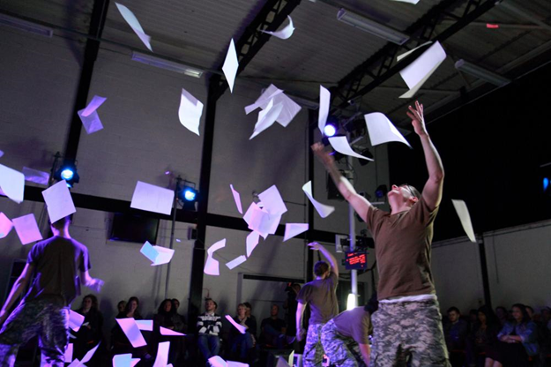
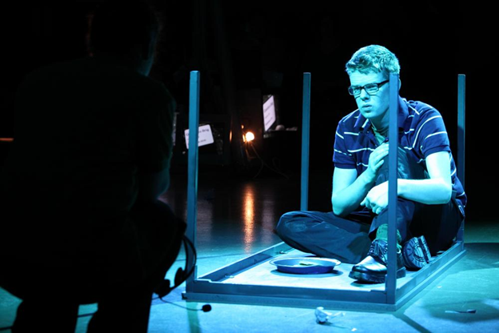
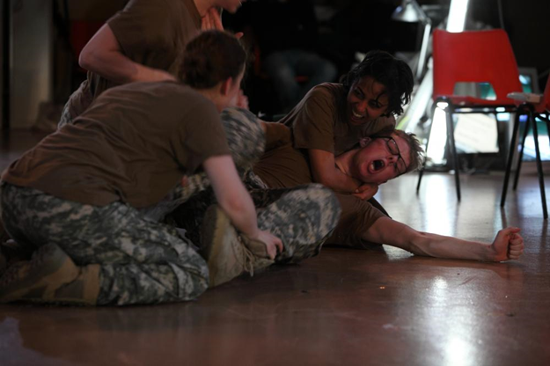
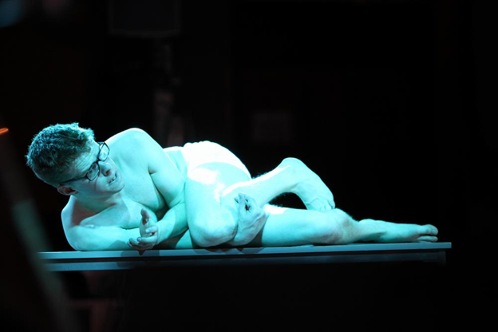
Harry Ferrier (top left & bottom left) and Matthew Aubrey (top right & bottom right) as ‘Bradley’ in Tim Price’s The Radicalisation of Bradley Manning (NTW 2012)

Slide 20
The play is a fictional account which has been inspired by a true story. The incidents, characters and timelines have been changed for dramatic purposes. In some cases, fictitious characters and incidents have been added to the plot, and the words are those imagined by the author. The play should not be understood as a biography or any other factual account.
(‘Disclaimer’, NTW 2012)

Slide 21
At a meeting with super-swish lawyers Harbottle & Lewis (of phone-hacking fame) we were told that several of our legal worries were ‘novel’. Novel in the sense that there was neither case law nor legal precedent for many of the questions we were asking. Could we use some of the leaked material on stage? Was there a public-interest defence for work shown in a theatre? Could we libel real people in Bradley's life? Could the US military sue?
(Tim Price, ‘Why I'm writing a play about Bradley Manning, WikiLeaks whistle-blower’, The Guardian. 16 December 2011)

Slide 22
A HISTORY OF THE PRESENT?
works staged to deal with the issues and matters of the present (with the here and now of terrorism and its impact; with the here and now of young people rioting in the streets…)
special quality of theatre – its liveness, its incorporation of spectators into the here and now as witnesses – as key to understanding the function of documentary and verbatim? And political theatre more broadly?
overlap of temporalities – theatre time and historical time – provides theatre with an immediacy in its capacity to relate an audience to a real life event or current issue
capacity of theatre to form what Jill Dolan calls ‘a new public sphere in which to scrutinize … events’ (2005, 113), ‘to use performance as a forum for rehearsing the practice of politics’ (ibid., 114).

Slide 23
WHOSE HISTORY?
History is who’s telling it. It’s political, rhetorical, and personal at once.
(ROBBIE MCCAULEY, CITED IN WHYTE, 1993: 282)
Critiquing past historical interpretations is possible in part because of a heightened awareness of diverse cultural perspectives, especially the perspectives of those who, having neither power nor wealth, have had little voice in how history is written.
(ZARRILLI, MCCONACHIE, WILLIAMS, FISHER SORGENFREI, 2006: XXIV)

Slide 24
WHOSE HISTORY?
History is who’s telling it. It’s political, rhetorical, and personal at once.
(ROBBIE MCCAULEY, CITED IN WHYTE, 1993: 282)
Critiquing past historical interpretations is possible in part because of a heightened awareness of diverse cultural perspectives, especially the perspectives of those who, having neither power nor wealth, have had little voice in how history is written.
(ZARRILLI, MCCONACHIE, WILLIAMS, FISHER SORGENFREI, 2006: XXIV)
How events are remembered, written, archived, staged, and performed helps determine the history they become. More than enacting history, although it certainly does that, documentary theatre also has the capacity to stage historiography.
(MARTIN, 2006: 9)

Slide 25
WHOSE ‘TRUTH’?
… the presence of a truth claim based on the incorporation of documents into narrative remains the unique claim of documentary form, as opposed to other forms of narrative fiction such as the novel. And although it might seem that postmodernism would gradually empty documentary of its authority if not its appeal, that is not what has happened.
(REINELT, 2006, P. 83)
the term “verbatim theatre” tends to fetishize the notion that we are getting things “word for word,” straight from the mouths of those “involved”’
(BOTTOMS, 2006: 59)

Slide 26
SUMMARY: POST-1968 THEATRE FROM 1’000 FEET
a period of significant political and economic change (and sometimes protest), marked by challenges to existing hierarchies of cultural knowledge and, accordingly, social and political authority
some major developments in form and content which we now take for granted as part of the UK’s theatre landscape (e.g. rural touring, explicit appearance of LGBT characters); increasing significance of collaborative models of theatre practice (sometimes with the explicit intention of challenging existing artistic / professional hierarchies)
dissipation of some older forms of control and constraint (e.g. direct censorship) which has informed – and in some cases allowed – experimentation in theatrical form and content.. but also emergence of new demands as described by particular relationships to context and audience
emergence (or perhaps more accurately re-emergence) of ethical and political imperatives for performance making – theatre that becomes increasingly conscious of the consequences of its own methodologies?
Notes:
some of these demands are ‘external’ (discovered or encountered at the moment of performance) and some are ‘internal’ to the process of creation itself (describing particular political or ethical ambitions)

Slide 27
The theatre can never cause a social change. It can articulate the pressures towards one, help people to celebrate their strengths and maybe build their self-confidence. It can be a public emblem of inner, and outer, events, and occasionally a reminder, an elbow-jogger, a perspective bringer. Above all, it can be the way people find their voice, their solidarity and their collective determination.
JOHN MCGRATH 1981: XXVII, EMPHASIS ADDED

Slide 28
We can’t know whether theatre changes the world, because we don’t have a control world without theatre, against which to compare the fortunes of our own. […] A more developed version of the same thought is this: we don’t know whether theatre can change the world because not all the results are in yet. We haven’t made all the theatre yet.
…we can insist that the question of theatre changing the world is in some degree redundant, because we know these two other things to be true: that in theatre – more clearly in theatre that knows it is incorporative – we can act, consequentially; and the world is changing anyway.
CHRIS GOODE, THE FOREST AND THE FIELD (2013)

